Slide 1
Processes and Threads
Distributed Computer Systems
CT024-3-3-DCOMS and Version 0416

Slide 2
Topic & Structure of The Lesson
Processes
Threads
Interprocess communication
Classical IPC problems
Scheduling

Slide 3
Learning Outcomes
At the end of this topic, You should be able to
Understand the Processes
Understand how Threads can be used
Understand the IPC
Explaining about the Scheduling

Slide 4
Key Terms You Must Be Able To Use
If you have mastered this topic, you should be able to use the following terms correctly in your assignments and exams:
Process
Thread
Inter Process Communication
Scheduling

Slide 5
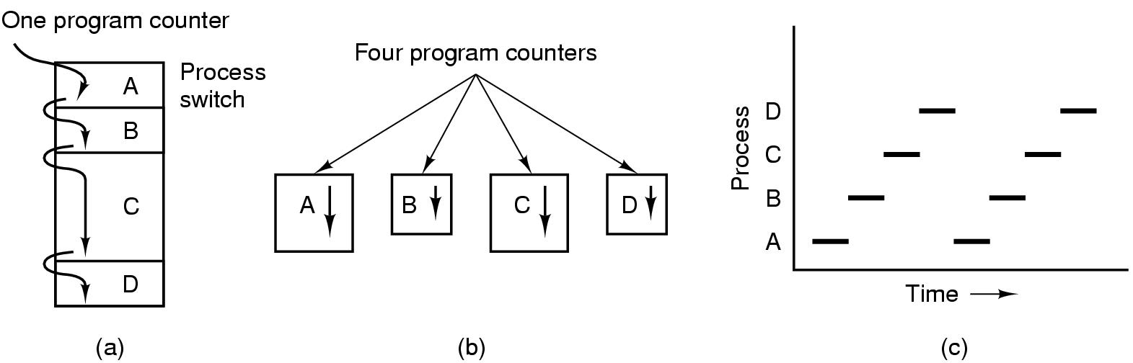
Processes The Process Model
Multiprogramming of four programs
Conceptual model of 4 independent, sequential processes
Only one program active at any instant

Slide 6
Process Creation
Principal events that cause process creation
1. System initialization
2. Execution of a process creation system
3. User request to create a new process
4. Initiation of a batch job

Slide 7
Process Termination
Conditions which terminate processes
Normal exit (voluntary)
Error exit (voluntary)
Fatal error (involuntary)
Killed by another process (involuntary)

Slide 8
Process Hierarchies
Parent creates a child process, child processes can create its own process
Forms a hierarchy
UNIX calls this a "process group"
Windows has no concept of process hierarchy
all processes are created equal

Slide 9
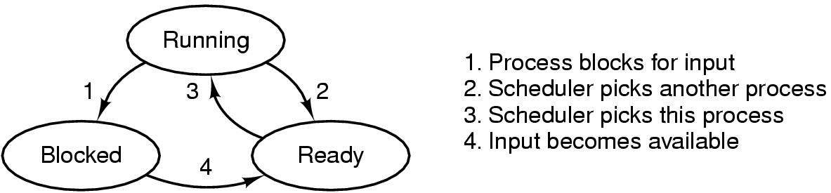
Process States (1)
Possible process states
running
blocked
ready
Transitions between states shown

Slide 10
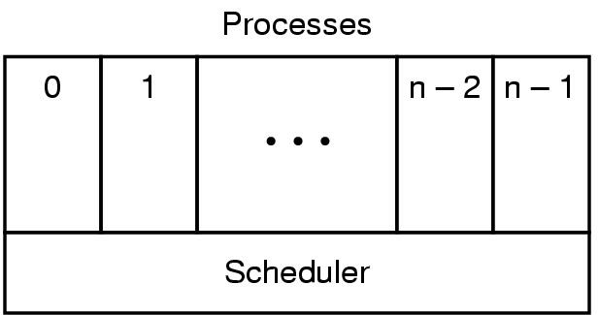
Process States (2)
Lowest layer of process-structured OS
handles interrupts, scheduling
Above that layer are sequential processes

Slide 11
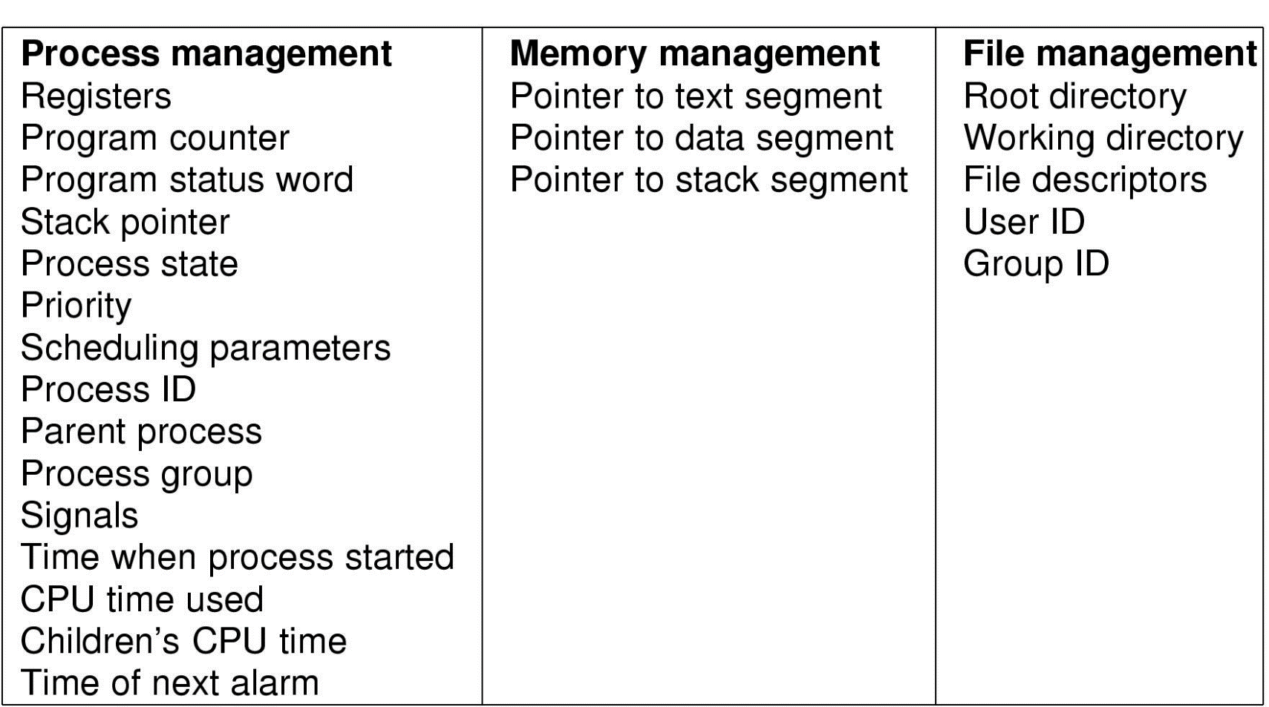
Implementation of Processes (1)
Fields of a process table entry

Slide 12
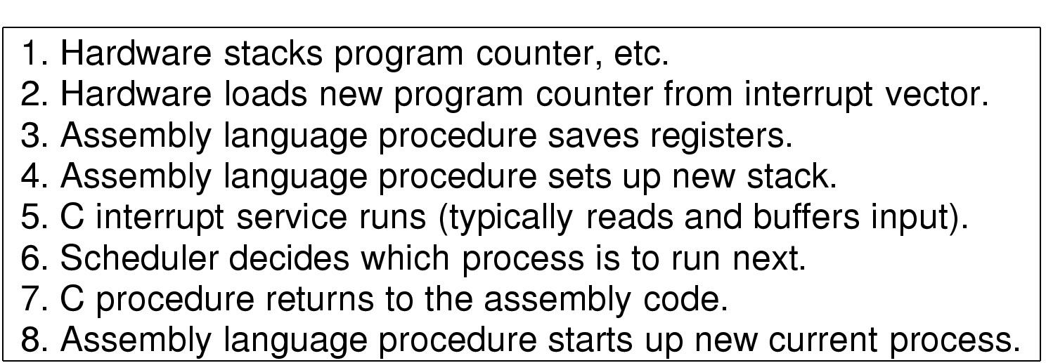
Implementation of Processes (2)
Skeleton of what lowest level of OS does when an interrupt occurs

Slide 13
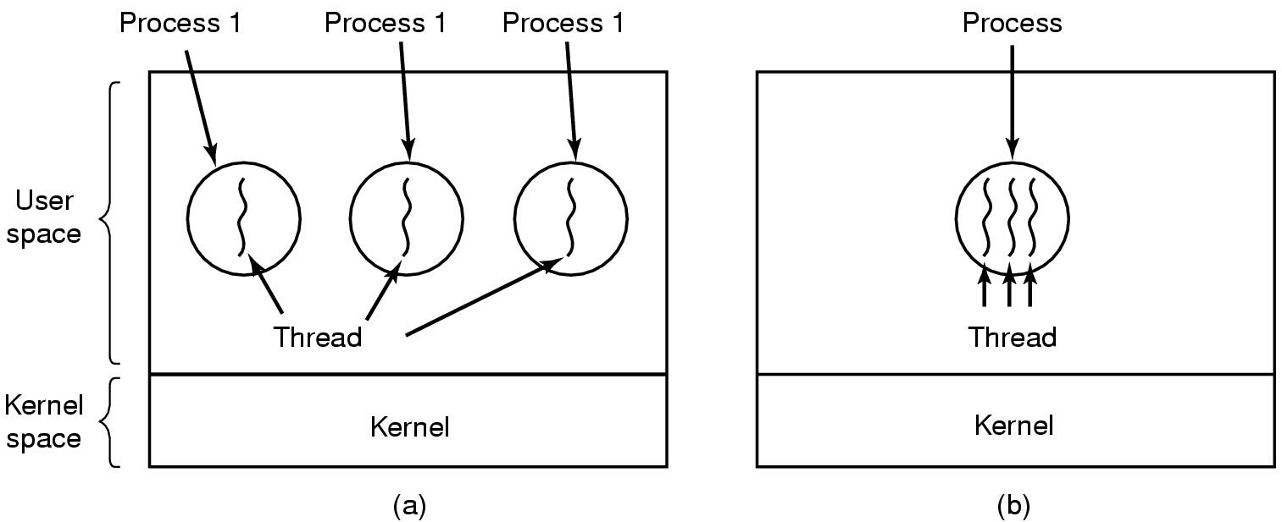
Threads The Thread Model (1)
(a) Three processes each with one thread
(b) One process with three threads

Slide 14
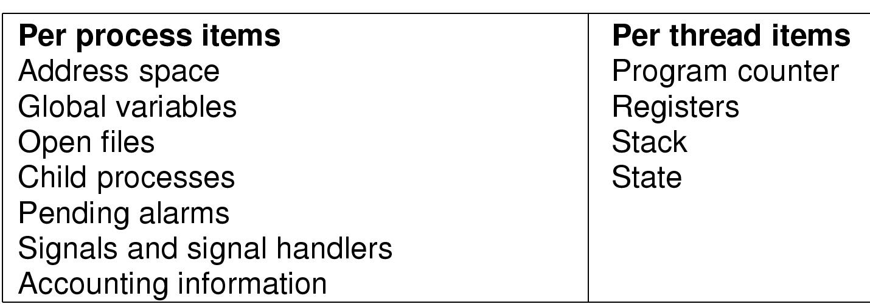
The Thread Model (2)
Items shared by all threads in a process
Items private to each thread

Slide 15
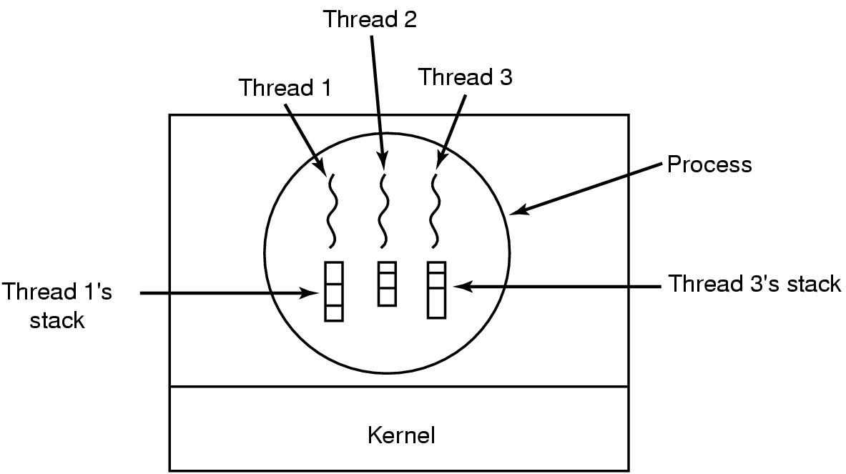
The Thread Model (3)
Each thread has its own stack

Slide 16
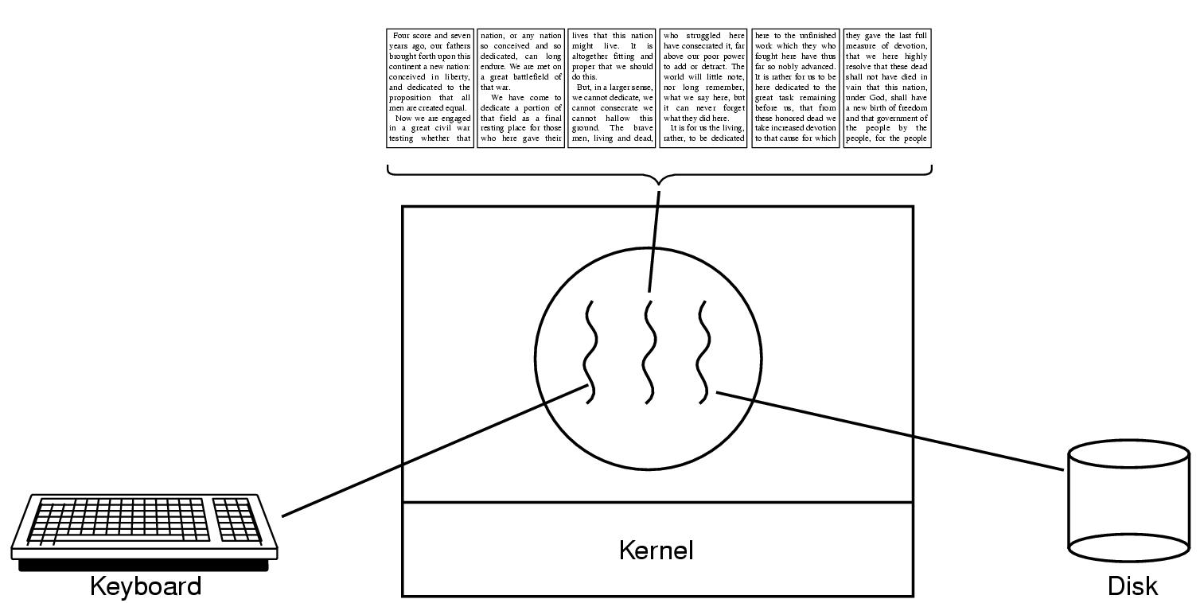
Thread Usage (1)
A word processor with three threads

Slide 17
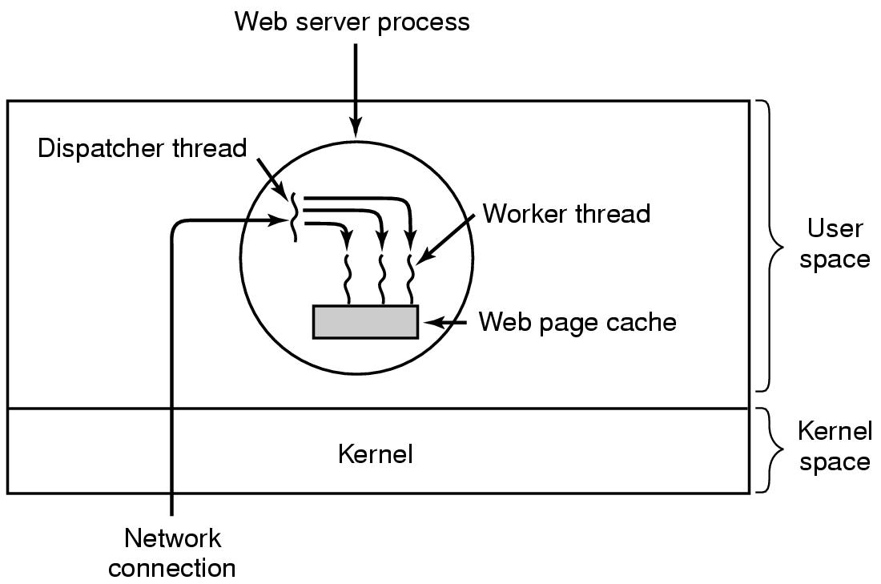
Thread Usage (2)
A multithreaded Web server

Slide 18
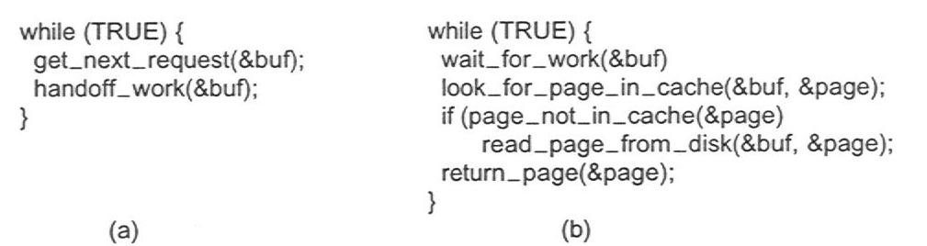
Thread Usage (3)
Rough outline of code for previous slide
(a) Dispatcher thread
(b) Worker thread

Slide 19
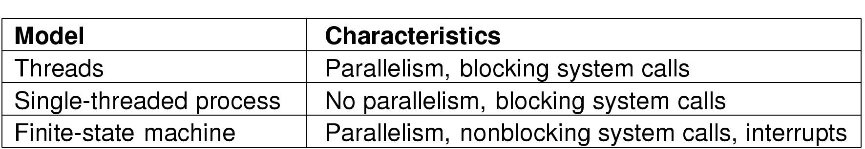
Thread Usage (4)
Three ways to construct a server

Slide 20
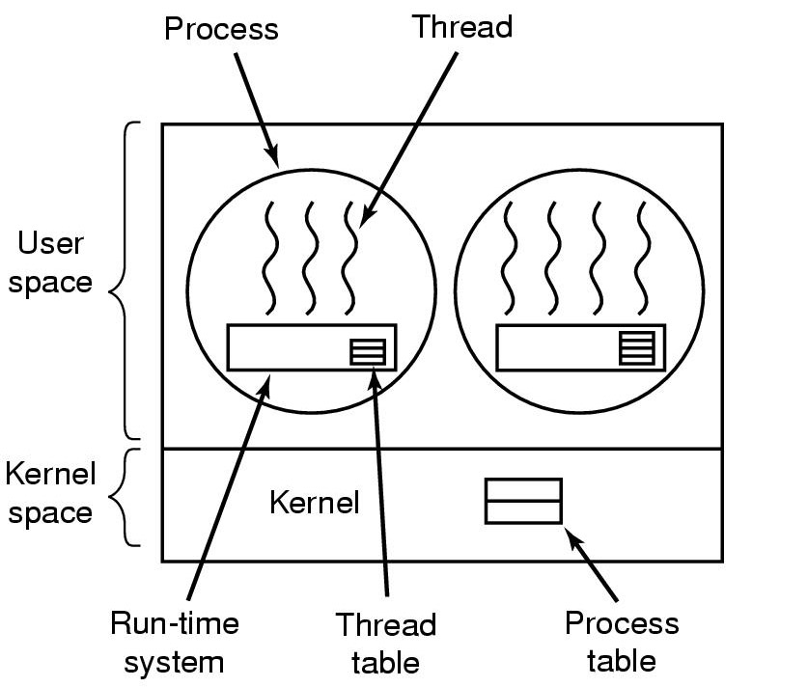
Implementing Threads in User Space
A user-level threads package

Slide 21
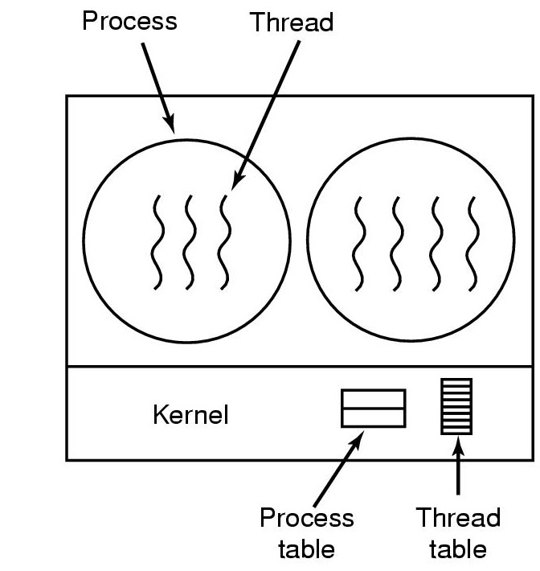
Implementing Threads in the Kernel
A threads package managed by the kernel

Slide 22
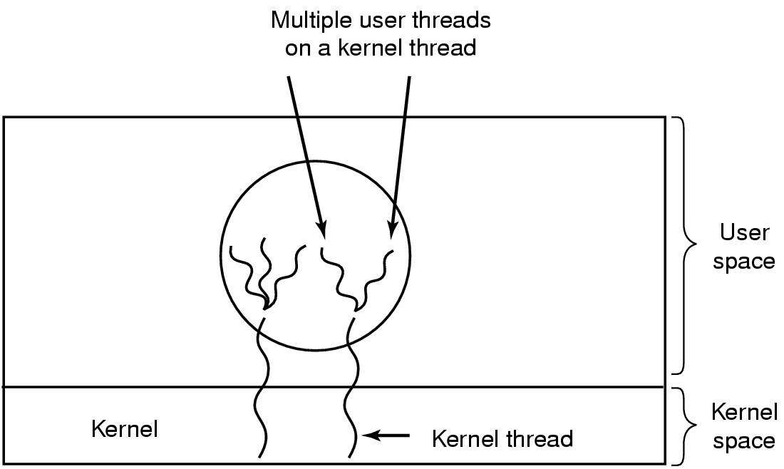
Hybrid Implementations
Multiplexing user-level threads onto kernel- level threads

Slide 23
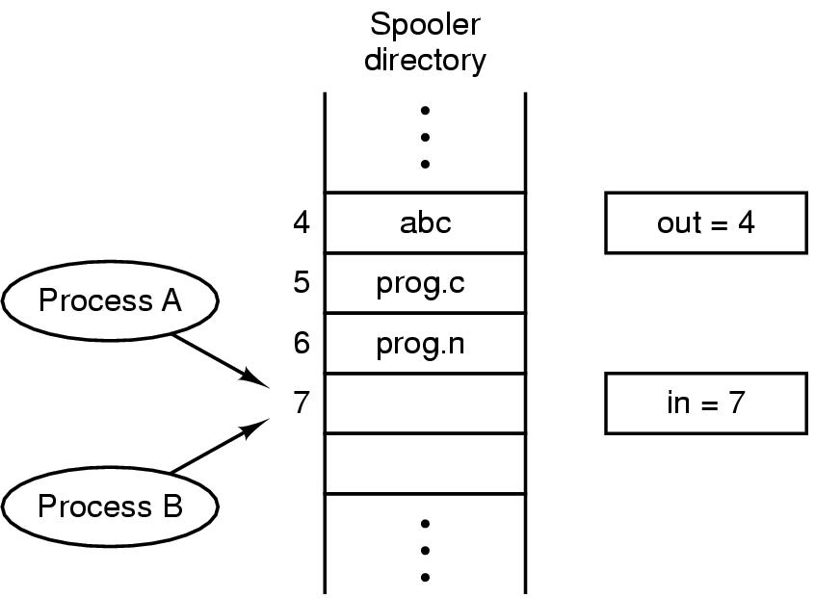
Interprocess Communication Race Conditions
Two processes want to access shared memory at same time

Slide 24
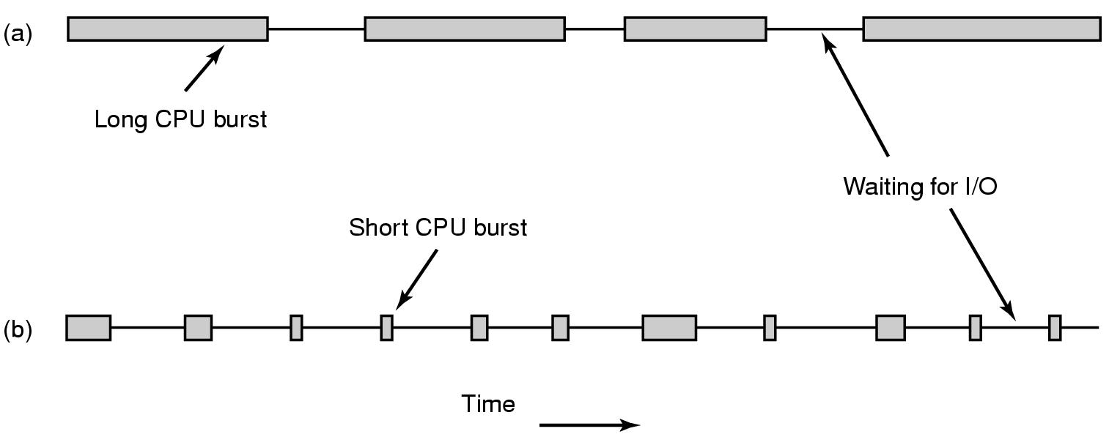
Scheduling Introduction to Scheduling (1)
Bursts of CPU usage alternate with periods of I/O wait
a CPU-bound process
an I/O bound process

Slide 25
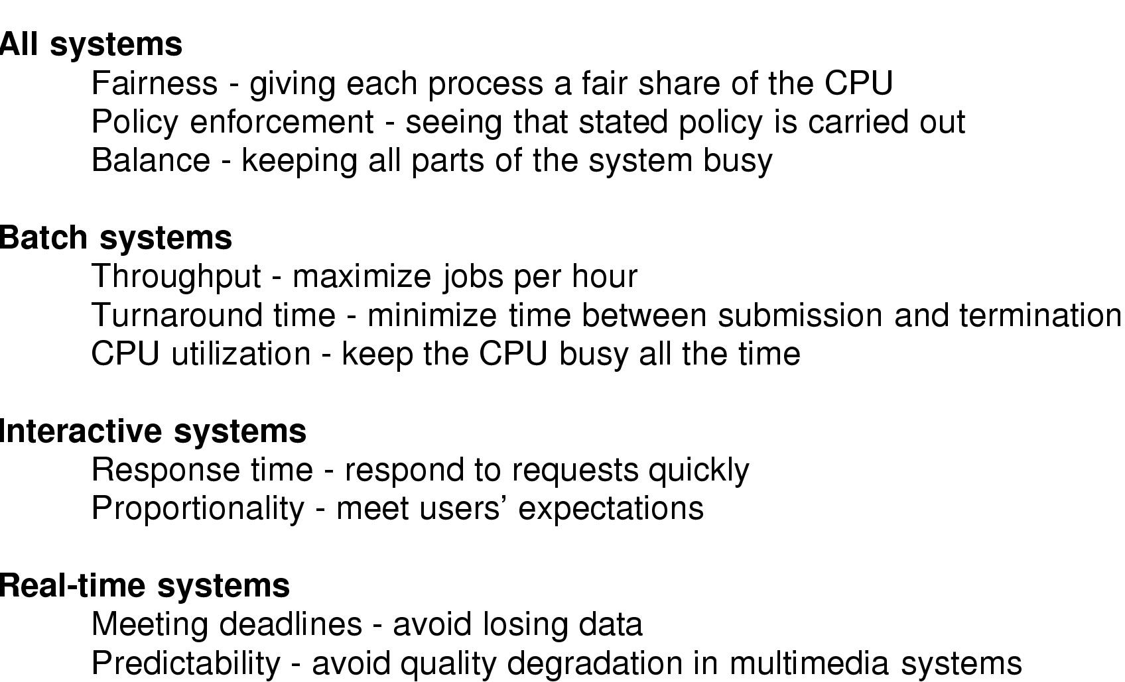
Introduction to Scheduling (2)
Scheduling Algorithm Goals

Slide 26
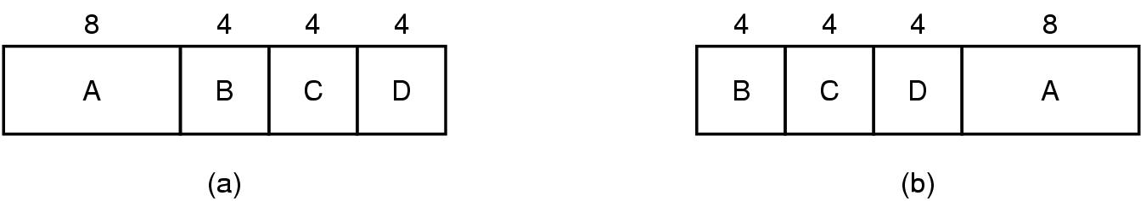
Scheduling in Batch Systems (1)
An example of shortest job first scheduling

Slide 27
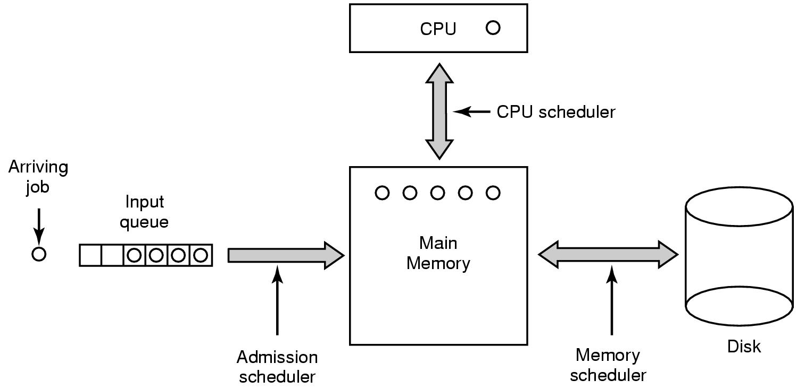
Scheduling in Batch Systems (2)
Three level scheduling

Slide 28
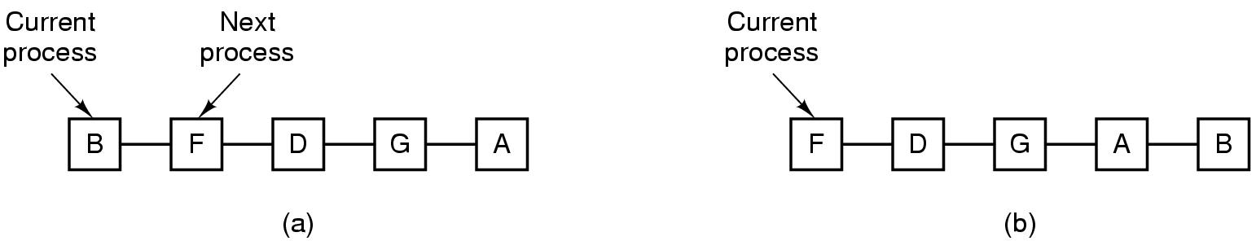
Scheduling in Interactive Systems (1)
Round Robin Scheduling
list of runnable processes
list of runnable processes after B uses up its quantum

Slide 29
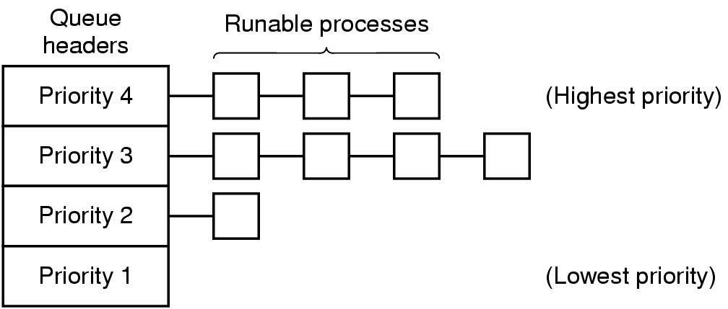
Scheduling in Interactive Systems (2)
A scheduling algorithm with four priority classes

Slide 30
Scheduling in Real-Time Systems
Schedulable real-time system
Given
m periodic events
event i occurs within period P_{i} and requires C_{i} seconds
Then the load can only be handled if

Slide 31
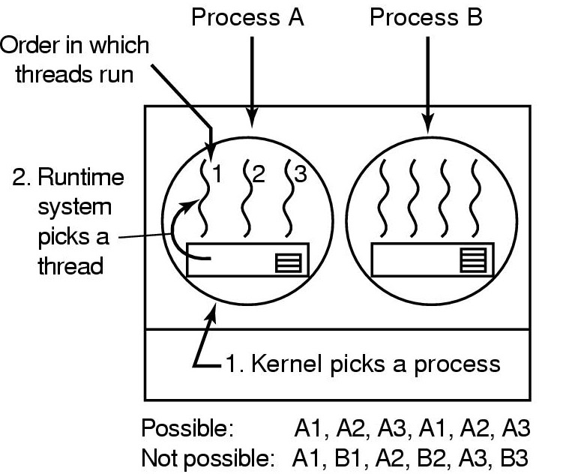
Thread Scheduling (1)
Possible scheduling of user-level threads
50-msec process quantum
threads run 5 msec/CPU burst

Slide 32
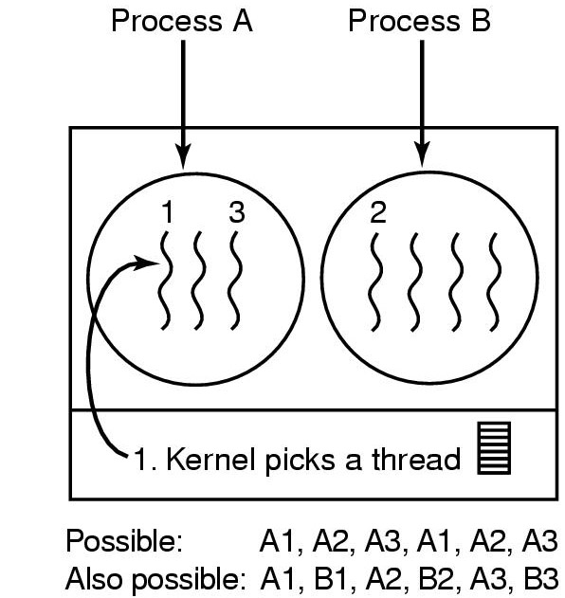
Thread Scheduling (2)
Possible scheduling of kernel-level threads
50-msec process quantum
threads run 5 msec/CPU burst

Slide 33
Threads
A thread is a single flow of control within a program
Normally we might have a server and many client in any webserver, how the server will server all client?

Slide 34
Java Threads
In Java, programming with multiple threads of control is relatively easy
Concentrate on a single thread of execution for a specific task
execution environment (Java VM) and operating system handle the scheduling and task switching
Two objects are always involved in running java threads
A Java language object: java.lang.Thread
A “target” object that c thread to execute

Slide 35
Java Threads
There are two possibilities to creating Threads:
1. Thread object extends class (extend java.lang.Thread)
2. Thread object implements interface (implement java.lang.Runnable)

Slide 36
Java Threads Main Methods
To control a threads in Java there are number of methods such as:
run()
Implements the code to be executed
start()
Starts a thread
sleep()
A thread will wait for the specified amount of time
join()
Synchronizes execution between threads
yield()
Switch process between threads

Slide 37
Summary
Process is an instance of a computer program that is being executed
Process has 4 conceptual models
- Process creation, process termination, process state, process hierarchy
Thread is called light-weight process and it share the resources of parent process
Various threads are wait(), join(), sleep(), run(), abort(), stop()

Slide 38
Question and answer session
Q & A

Slide 39
What we will cover next
Thread Synchronization

